Slide 1
Class Project:
Focused Investigation
Astro 289: Adaptive Optics
February 6, 2020
Thanks to Katie Morzinski for developing this series of activities

Slide 2
Purpose of Starter: To introduce existing AO systems and get you thinking about science goals and design choices
Comparing/contrasting several different AO systems and their results when imaging the same extrasolar planetary system (HR 8799)
Discussion
Goal-driven design: iterative
  Science Case Performance Requirements
Expectations for final presentation / mini-CoDR
A bit about Project Management

Slide 3
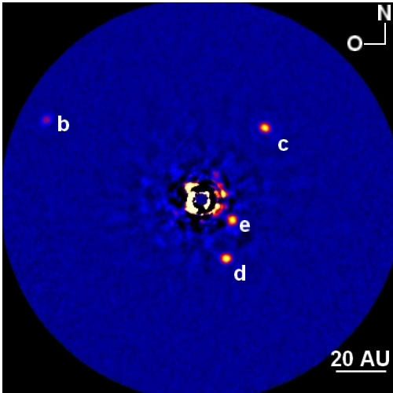
HR 8799 Planetary System

Slide 4
HR 8799 Planetary System
Observation Details
Science Results
System | AO System/Science Camera | Special Observational Techniques | λ observed | HR8799 Planets imaged (b/c/d/e) | SED (Temp of planets) (Yes/No) | Orbits/ Positions (Yes/No) | Strehl ratio
LBT | FLAO/PISCES | ADI/2D star subtraction | H, Ks | b,c,d,e | No | Yes | 80+%
Keck | Keck AO/NIRC2 | ADI, LOCI | H, K, L | b,c,d,e | Yes | Yes | 60% ?
MMT | MMTAO | PSF subtractions | 3.8 mic, 3.1, 4.8 | b,c,d only at 3.8 mic | Yes | Yes | ??

Slide 5
AO System Parameters
System | Telescope Diameter | Site/ro | DM and dof | WFS Type | AO Bench location (Cassegrain? Nasmyth?)
LBT | 8.4 | 13 cm | 627 DSM | Pyramid | Bent Gregorian
Keck | 10 | 20-25 cm | 249 Contin. Face Sheet | S-H | Nasmyth
MMT | 6.5 | 12 cm | 336 DSM | S-H | Ritchie-Chretien Seconday

Slide 6
Here are images of the HR 8799 planetary system with these three AO systems

Slide 7
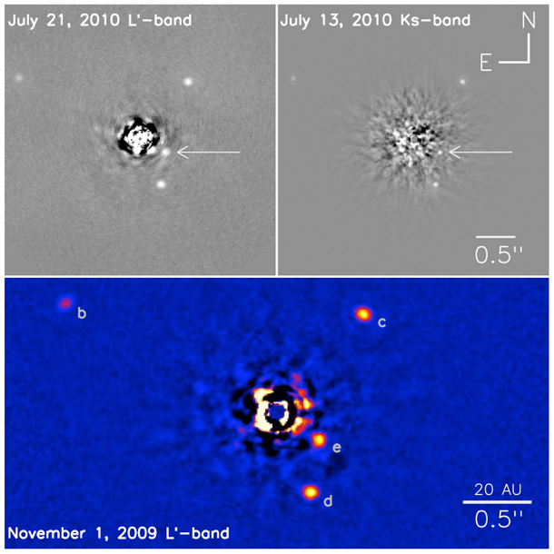
Keck 2 AO

Slide 8
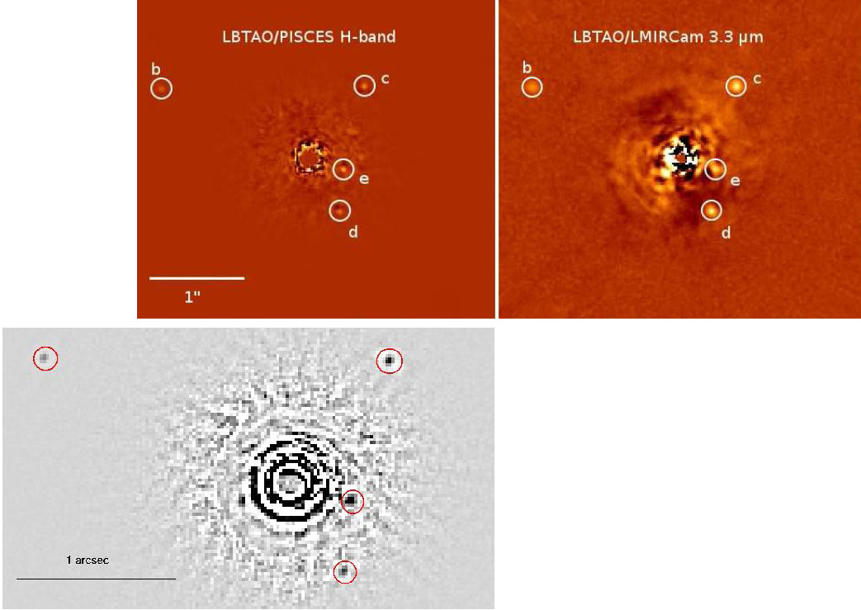
LBT H-band (1.6 microns) and 3.3 microns
H band

Slide 9
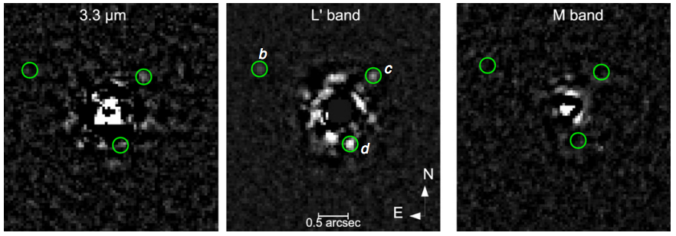
MMT AO 3.3 – 4.8 microns
2 planets detected
3 planets detected
0 planets detected

Slide 10
Discussion about comparative AO
Which AO system would you use for HR8799?
What science would you be aiming at?
Which AO system would you use for finding other types of planets?
Why did they use different DM’s?
Why did they use different WFS’s?

Slide 11
Where are we going with this?
Flow Chart for Goal-Driven Design
Defining your Performance Requirements
Expectations for your Project at class presentation (“mini-CoDR”)

Slide 12
Goal-driven design: Design AO system/select AO components based on science goals
Science Case
Performance Requirements and Science λ
Sky coverage
PSF quality/Strehl requirement
Field of view
Guide star
Residual wavefront error
Beam size
Wavefront sensor noise
Time delay
Fitting error
G.S. magnitude
bandwidth
# subaps
Reference
“Star"
Wavefront
Sensor
Control
System
Deformable
Mirror
Optics
This slide based on flow charts and concepts from O. Guyon’s talk on AO system design: Astronomy at 2009 CfAO AO Summer School at UCSC, R. Parenti’s chapter 2 in AO Engineering Handbook ed. R. Tyson 2000, and J. Hardy chapter 9 AO for astronomical telescopes 1998.
Notes:
Wavefront sensor noise: How well do you measure the wavefront?
Time delay: How well do you fit the wavefront in time?
Fitting error: How well do you fit the wavefront in space?

Slide 13

Performance Requirements: Example
(Step 1) Science Case | (Step 2) Performance Requirements -- Physical Parameters | (Step 3) Performance Requirements -- Observables to Measure
How many brown dwarfs are orbiting stars in the Hyades cluster? | Parameter space for search: Brown dwarf dist. 5 - 250 AU from parent star. Minimum (and faintest) brown dwarf mass: 0.003 x M_{sun} (L / T dwarf transition) Contrast ratio between planet and star: 10⁻⁴ at close separations | Search space: 0.1-10 arc seconds from parent star. Sensitivity limit: H-band magnitude~13 Contrast between planet and star: ΔH~10 magnitudes (factor of 10⁴)
_{Notes:}
1 AU = distance from earth to Sun
H band is centered at a wavelength of 1.6 microns
Magnitude: “Faintness" as viewed from Earth.
Notes:
Note: There is iteration between Science Case and Performance Requirements. For example, it is not possible to image an infinitesimally small planet next to a bright star-- so you have to decide what is a doable performance requirement that will achieve the science results you are most interested in.
This is where you may need expert assistance, as we won’t have time this quarter to figure it out with our own Monte Carlo simulations of expected results.

Slide 14
Defining Performance Requirements based on Goal
Resources:
  Advisors
    Your research advisor/colleagues/professors
    Or I can put you in touch with an AO instrumentation expert in your field – please ask
  White Papers for astronomy teams:
    Astro 2010 Decadal Survey:
      Science White Papers:
        https://baas.aas.org/community/astro2020-science-white-papers/
      Project White Papers (including instruments):
        https://baas.aas.org/community/astro2020-apc-white-papers/
Iterate with me by email.

Slide 15
Goal-driven design: Starting with science goal vs. starting with performance requirements
What if you optimize your AO system to get the best performance?
Performance requirement:
  Get best possible contrast (dynamic range)
  What is the faintest planet we can image next to a bright star?
Leads to:
  This AO system would need such a bright natural guide star to measure the wavefront that it could only observe the ~10 brightest nearby stars that exist.
What if you optimize your AO system to do the best on your science goal?
Science goal:
  Image exoplanets
  How frequent are Jupiter-type exoplanets seen around solar-type stars?
Leads to:
  Observing hundreds of nearby stars and counting which ones have Jupiter-type exoplanets orbiting them.

Slide 16
Expectations for Final Project Presentations: mini-CoDR
(CoDR = Conceptual Design Review)

Slide 17
Conceptual Design Review (CoDR)
Basic science goal and performance requirements
Purpose: Demonstrate feasibility of design to solve problem/answer question
Describe system and sub-components but doesn’t have to show they’re the best design
Identify areas of technical risk, for example new technologies or techniques

Slide 18
mini-CoDR Expectations
Instrument name
Science goals
Performance requirements flowing from science goals
Proposed telescope/location
DM (type, dof)
WFS (type, sensitivity, # subapertures)
Science instrument (IR imager, optical spectrograph, …)
Block diagram of AO system
Type and magnitude of reference “star” (natural, laser)
Field of view
Wavefront error budget
Describe the main risks

Slide 19
Bonus @ mini-CoDR
Acronym for your AO system/instrument
Logo (!)
Your Roles: Principle Investigator (PI), Project Scientist, Project Manager, user
Optical layout
Observing plan/how data will be gathered
Plan for data reduction/pipeline
Project timeline
Estimate (guess?) total project cost

Slide 20
Project Due Dates
Today: Starters. Choosing AO parameters.
February 11th: Focused Investigation - Specific science question you want to answer with your AO systems
Feb 18: Performance Requirements - First draft due. Iterate with me, especially if you need more help than White Papers and local experts.
Second half of February: Move from performance requirements to AO design
March 5th: Project Presentations
March 10th: Project Synthesis

Slide 22
FYI
Project Management Overview

Slide 23
Project Management: Levels of Design Reviews
Conceptual Design Review (CoDR)
  a.k.a. Feasibility Design Review
Preliminary Design Review (PDR)
Critical Design Review (CDR)
Pre-Ship Review
Integration and Testing
Commissioning
Facility-Class Instrument
Note: Terminology and definitions are approximate, and vary from community to community

Slide 24
Conceptual Design Review (CoDR)
Basic science goal and performance requirements
Purpose: Demonstrate feasibility of design to solve problem/answer question
Describe system and sub-components but doesn’t have to show they’re the best design
Identify areas of technical risk, for example new technologies or techniques
http://www.ing.iac.es/~docs/wht/naomi/wht-naomi-87/wht-naomi-87.html

Slide 25
Preliminary Design Review
Detailed science goal and performance requirements
Operational requirements/constraints
Timeline/plan for building
Details about instrument design
Cost/budget
Alternate choices under consideration
Plan for mitigating risks
http://www.ing.iac.es/~docs/wht/naomi/wht-naomi-87/wht-naomi-87.html

Slide 26
Critical Design Review
Full designs for individual components
Full design for system
Detailed plan for building
Timelines and Gantt charts
Budget review
Scale models
Simulations

Slide 27
Final Stages
Pre-Ship Review
  Do subsystem components meet spec? Are they ready to ship to telescope?
Integration and Testing
  Put all components together and run performance tests under realistic observing conditions
Commissioning
  On-sky testing of anything that couldn’t be tested in lab, and in regular observing mode
Facility-class Instrument
  At this stage, the instrument is finished “engineering” and is now ready for “science” by the wider user community!

